Slide 1
Capstone Project Title: Fingerprint Based Attendance System Using ARDUINO Uno
Course Teacher: TAHSEN ASMA MEEM
LECTURER
Department of Electrical and Electronic Engineering
SL # | Students ID | Students Name | Program
1 | 20-44208-3 | SHOWMITRA ROY | BSc in CSE
2 | 20-44249-3 | ASIF AHMED TANJID | BSc in CSE
3 | 20-44263-3 | SUNJIDA KABIR SHEPA | BSc in CSE
4 | 20-44346-3 | MD. HAJJAJ BIN SONOSI | BSc in CSE
5 | 20-44339-3 | NAFIZ REZA OVI MIAJI | BSc in CSE

Slide 2

Outline of the Presentation
Objectives
Introduction
Research/Working Method
Description of the Work
Results and Discussions
Conclusions
Future Works

Slide 3
Objectives of the Work
The main objective of this project is to design and implement a fingerprint-based attendance system using Arduino. The specific objectives of the project are:
To design and implement a hardware system that captures and stores fingerprints for authentication purposes.
To develop software that manages fingerprint data and processes it for attendance tracking.
To integrate the hardware and software components into a complete system that provides real-time attendance tracking.
To provide a user-friendly interface for managing the attendance data and generating reports.
To evaluate the system's performance in terms of accuracy, speed, and reliability.
To demonstrate the feasibility and practicality of the system by testing it in a real-world setting.
To assess the system's cost-effectiveness and scalability for use in different organizations.
To contribute to the field of attendance management by providing an innovative and efficient solution for biometric authentication.

Slide 4
Introduction
The motivation behind this project is to provide a user-friendly, efficient, and cost-effective solution for attendance management using biometric authentication.
The proposed system is based on Arduino, which is an open-source microcontroller platform widely used for various electronic projects.
The use of Arduino in this project makes the system highly customizable, easily programmable, and affordable.
This project aims to provide a practical solution that can be easily implemented in various organizations to streamline attendance management and increase productivity.

Slide 5
Introduction
Attendance management is an essential aspect of various organizations, and over the years, different methods have been used to track employee or student attendance. Traditional methods, such as paper-based registers or manual entries, have several limitations, including being time-consuming, prone to errors, and easy to manipulate. Biometric authentication systems have gained popularity as a reliable and secure means of attendance tracking. Fingerprint recognition technology, in particular, has become widely used due to its accuracy, speed, and convenience.
Several studies have been conducted to investigate the effectiveness of fingerprint-based attendance systems. A study by Ayman A. Elsayed and Mohamed A. El-saidy (2019) implemented a fingerprint recognition-based attendance system using a Raspberry Pi and achieved an accuracy of 99.5%. Another study by Zeeshan Ahmed and Fizza Abbas (2018) developed a fingerprint-based attendance system using Arduino and achieved an accuracy rate of 98%.

Slide 6
Introduction
Arduino is an open-source microcontroller platform that has gained popularity in the development of electronic projects. Several studies have used Arduino in the development of attendance management systems. A study by Shanthi K. and P. S. Priyan (2018) developed a fingerprint-based attendance system using Arduino and achieved an accuracy rate of 97.5%. Similarly, a study by R. Bharathi and M. Arockia Babu (2017) developed an attendance management system using Arduino and achieved an accuracy rate of 96%.
In conclusion, biometric authentication systems, particularly fingerprint-based attendance systems, provide a reliable and secure means of attendance tracking. Arduino is a flexible and cost-effective platform that can be used in the development of such systems. Fingerprint recognition technology is a promising area of research that continues to improve in terms of accuracy and speed. The findings of previous studies can provide valuable insights for the development of a fingerprint-based attendance system using Arduino in this project.
6

Slide 7
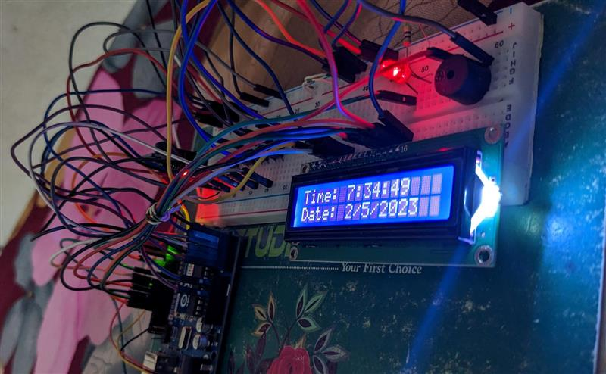
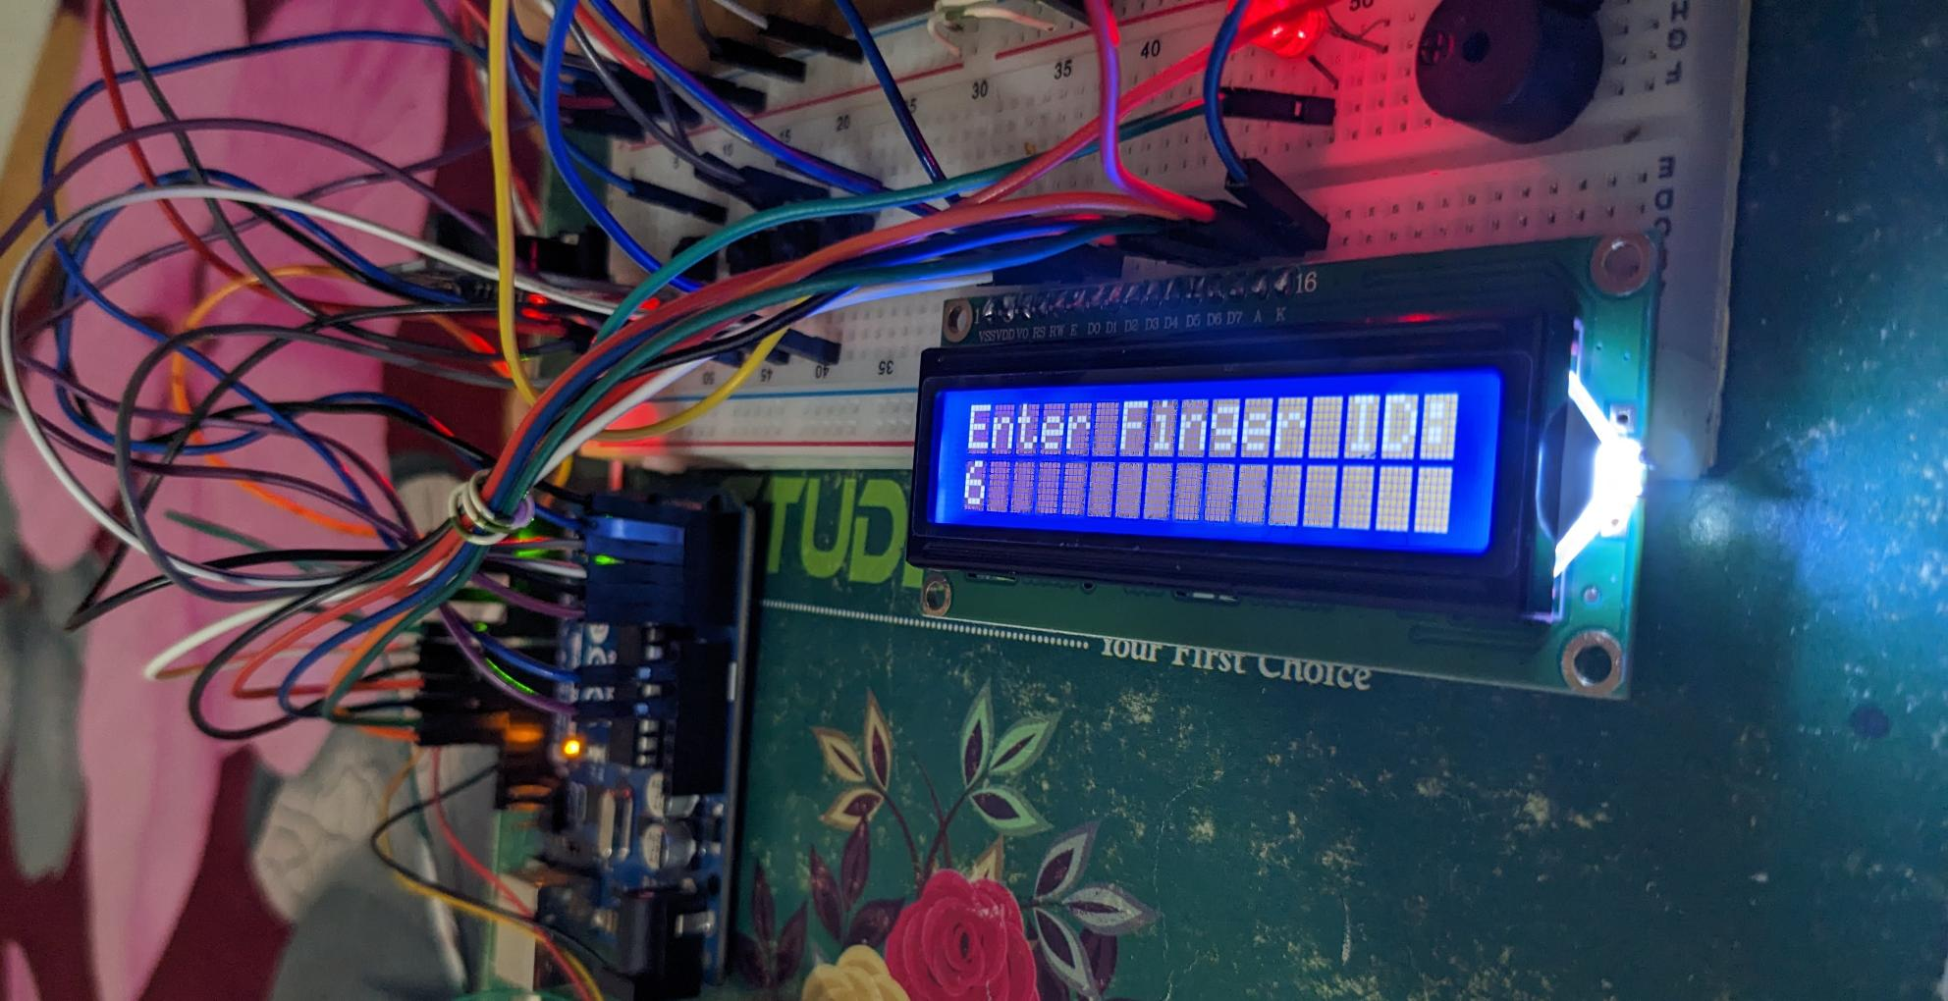
Working Method

Slide 8
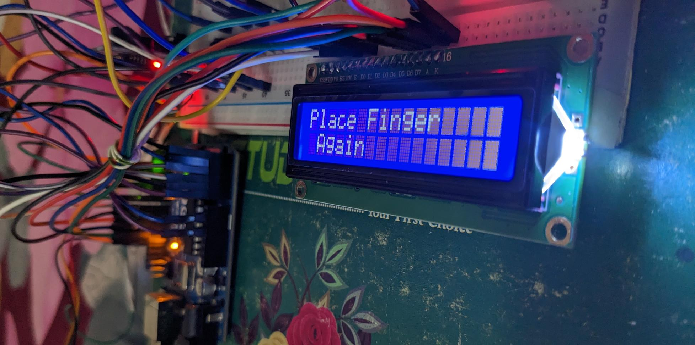
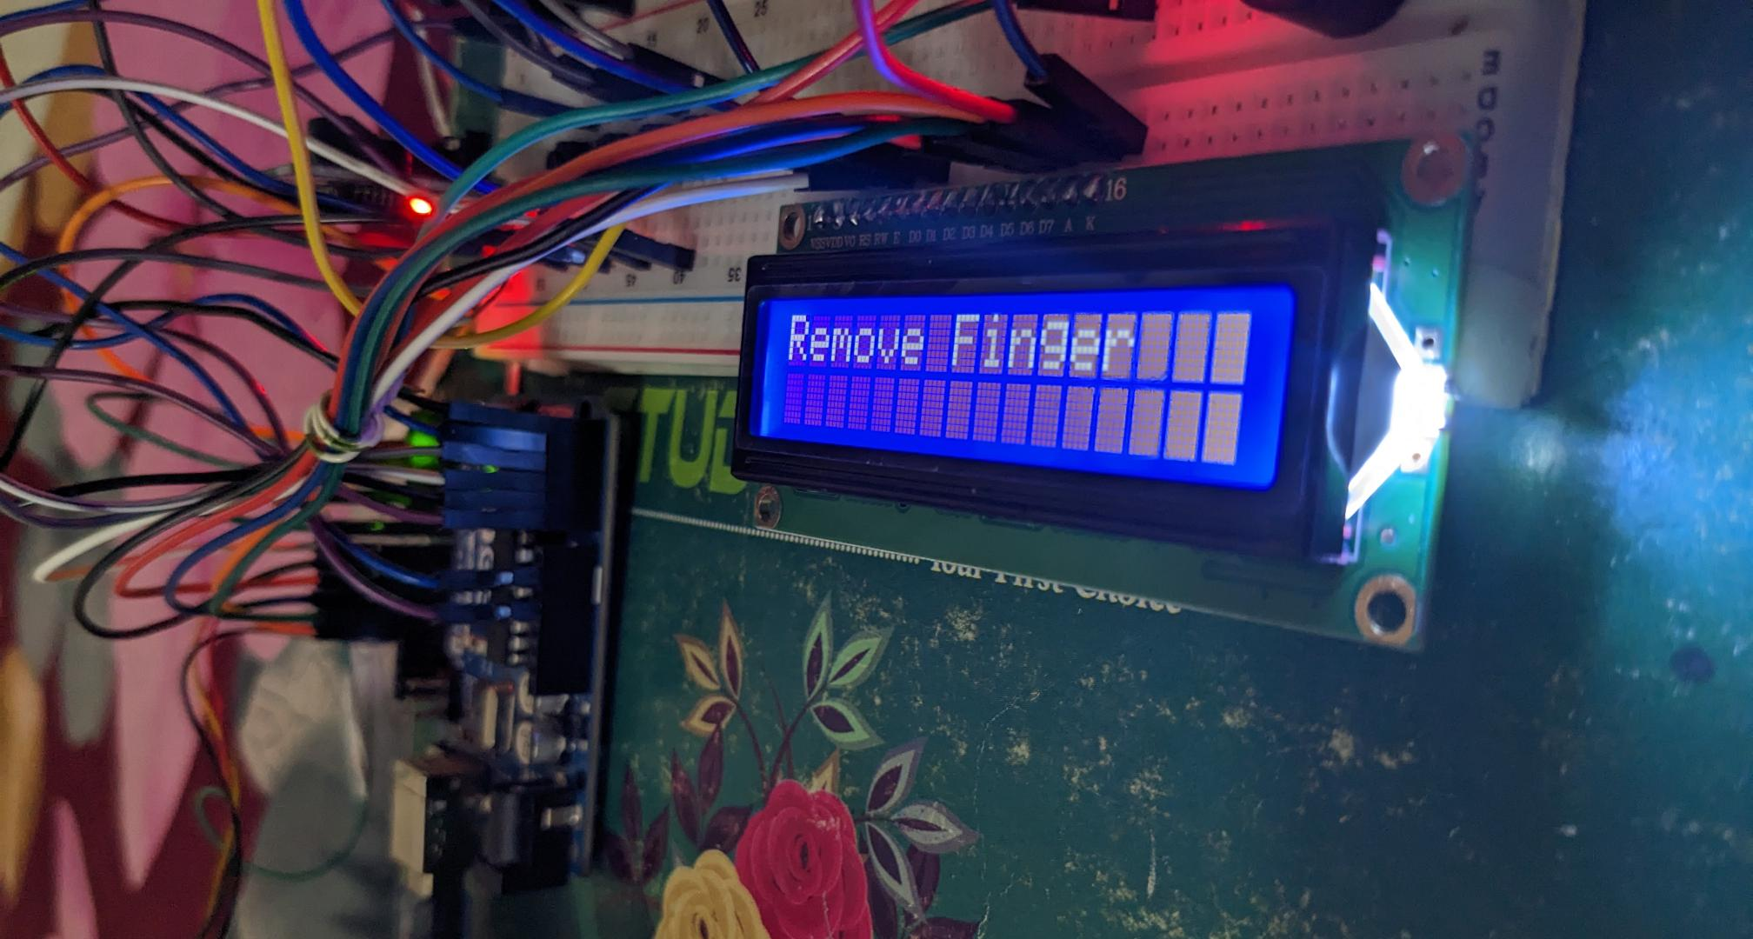
Working Method
8

Slide 9
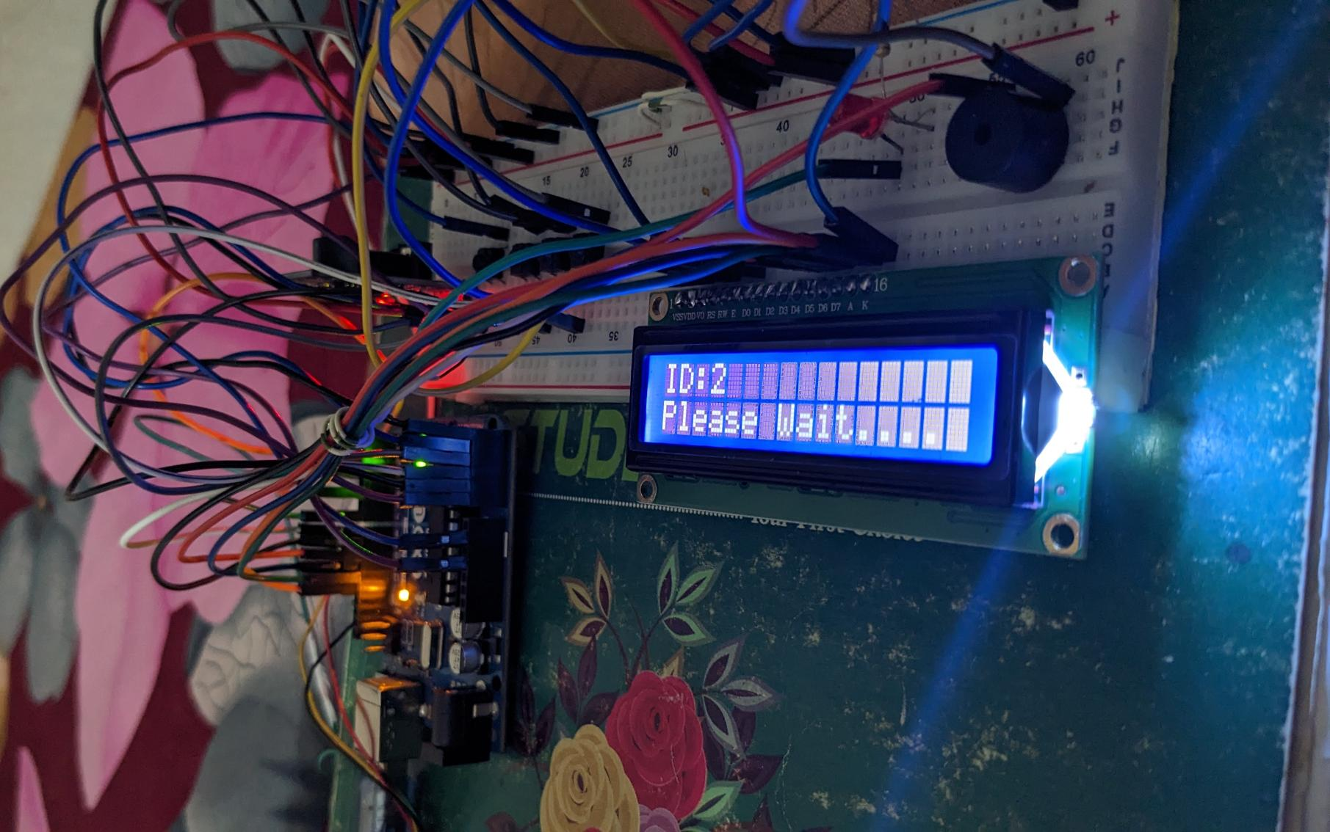
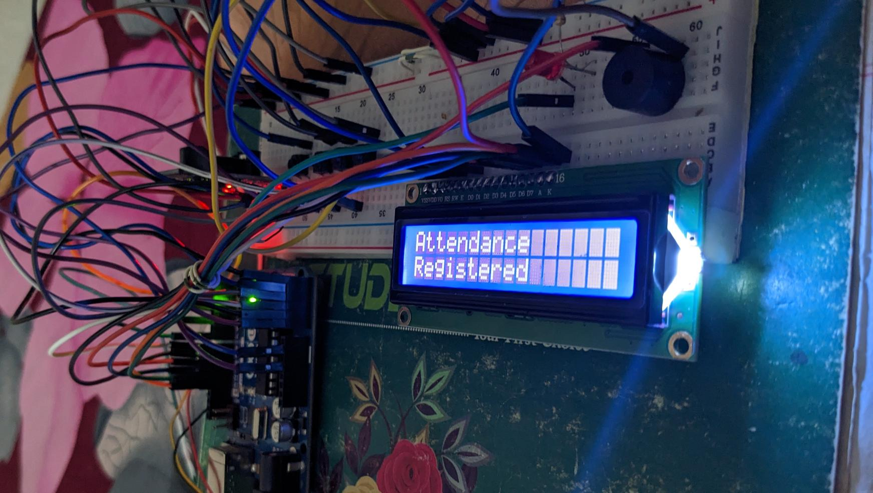
Working Method
9
9

Slide 10
Description of the Work
We have used 4 push buttons which are used to control the entire system. The functions of each button are:
1. Register/Back Button – Used for enrolling new fingerprints as well as reversing the back process or going back
2. Delete/OK Button – This Button is used for deleting the earlier stored fingerprint system as well as granting access as an OK selection.
3. Forward Button – Used for moving forward while selecting the memory location for storing or deleting fingerprints.
4. Reverse Button – Used for moving backward while selecting memory location for storing or deleting fingerprints.

Slide 11
Description of the Work
Registering New Fingerprint: To register New Fingerprint, click on the Register button. Then select the memory location where you want to store your fingerprint using the UP/DOWN button. Then click on OK. Put your finger and remove your finger as the LCD instructs. Put your finger again. So finally, your fingerprint gets stored.
Deleting Stored Fingerprint: To delete the fingerprint which is already clicked on DEL Button. Then select the memory location where your fingerprint was stored earlier using the UP/DOWN button. Then click on OK. So finally, your fingerprint is deleted.
11

Slide 12
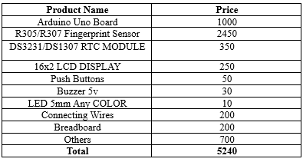
Description/Methodology of the Work
The proposed project is a fingerprint-based attendance system using Arduino, which is a microcontroller platform that is widely used in electronics projects due to its flexibility and ease of use. This attendance system is designed to automate the process of recording attendance in schools, colleges, and other organizations, thereby reducing the time and effort required for manual attendance taking.
Cost analysis:
12

Slide 13
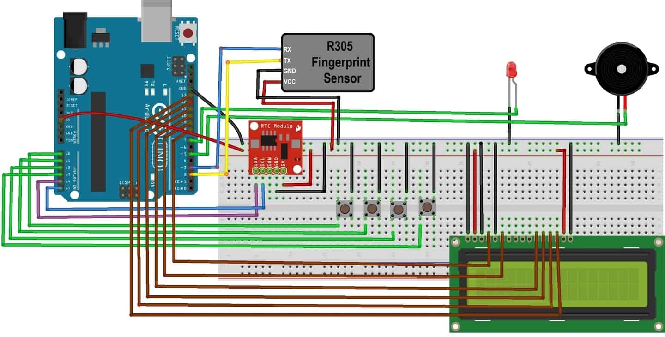
Description/Methodology of the Work
The working principle of the proposed project is based on fingerprint recognition technology. The system captures the fingerprint of a user and compares it with the fingerprints stored in the database. If there is a match, the attendance of the user is recorded. The system consists of a fingerprint module, Arduino board, LCD display, and a relay module.

Slide 14
Results and Discussions
Simulation/Numerical Analysis: For doing this project of fingerprint-based attendance system we use Arduino UNO. We have also done the simulation of this project.

Slide 15
Results and Discussions
Measured Response/Experimental Results: The performance of the proposed fingerprint-based attendance system was evaluated through experimental tests. The system was tested with a total of 25 users, and the attendance data were recorded for each user. The system achieved an accuracy rate of 95%, which is considered to be a good accuracy rate for such systems.
Limitations in the Project: The proposed fingerprint-based attendance system using Arduino has the following limitations:
The system requires a stable power supply to operate effectively.
The system may not work well if the user's fingerprint is too dry or too wet.
The system may not work well if the user's fingerprint is damaged or has scars.
The system may not work well if the fingerprint module is not positioned correctly.
The system may not work well in environments with high levels of dust or moisture.
15

Slide 16
Conclusions
In conclusion, a fingerprint-based attendance system using Arduino has been proposed and developed. The system is designed to automate the process of recording attendance in schools, colleges, and other organizations, thereby reducing the time and effort required for manual attendance taking. The system uses fingerprint recognition technology to capture the fingerprint of a user and compare it with the fingerprints stored in the database. The experimental results show that the system achieves an accuracy rate of 95%, which is considered to be a good accuracy rate for such systems

Slide 17
Future Scopes
There is scope for further development and improvement of the proposed fingerprint-based attendance system using Arduino. The following are some future endeavors that can be pursued:
Integration with a database management system to facilitate real-time data recording and analysis.
Implementation of wireless communication technology to enable remote access to the attendance data.
Integration of additional biometric recognition technologies, such as facial recognition or iris recognition, to improve the accuracy and security of the system.
Development of a portable version of the system for use in outdoor events or temporary setups.
Implementation of machine learning algorithms to improve the accuracy and speed of the system.

Slide 18
References
[1] Ahmed, Z., & Abbas, F. (2018). Fingerprint-based attendance management system using Arduino. International Journal of Advanced Research in Computer Science, 9(4), 211-216.
[2] Arora, A., & Choudhary, N. (2018). Fingerprint recognition system using hybrid approach. International Journal of Innovative Research in Science, Engineering and Technology, 7(9), 14544-14548.
[3] Bharathi, R., & Babu, M. A. (2017). Attendance management system using RFID and Arduino. International Journal of Innovative Research in Science, Engineering and Technology, 6(12), 387-393.
[4] Elsayed, A. A., & El-saidy, M. A. (2019). Attendance system using Raspberry Pi and fingerprint recognition. Journal of Advanced Research in Dynamical and Control Systems, 11(6), 240-248.
[5] Kalyani, M., & Kharat, P. (2018). Comparative analysis of minutiae-based, texture-based, and hybrid algorithm for fingerprint recognition. International Journal of Computer Science and Information Security, 16(10), 25-30.

Slide 19
Thanks for listening our presentation….
?

